Slide 1
Graphs: MSTs and Shortest Paths

Slide 2
Shortest paths
What is the shortest path from a to d?
B
D
A
C
E

Slide 3
Shortest paths
BFS
B
D
A
C
E

Slide 4
Shortest paths
What is the shortest path from a to d?
2
B
D
3
3
A
1
2
1
C
E
4

Slide 5
Shortest paths
We can still use BFS
2
B
D
3
3
A
1
2
1
C
E
4

Slide 6
Shortest paths
We can still use BFS
2
B
D
B
D
3
3
A
1
2
A
1
C
E
C
E
4

Slide 7
Shortest paths
We can still use BFS
B
D
A
C
E

Slide 8
Shortest paths
What is the problem?
B
D
A
C
E

Slide 9
Shortest paths
Running time is dependent on the weights
B
B
2
100
1
A
50
A
4
C
200
C

Slide 10
Shortest paths
B
B
100
A
50
A
200
C
C

Slide 11
Shortest paths
B
A
C

Slide 12
Shortest paths
B
A
C

Slide 13
Shortest paths
Nothing will change as we expand the frontier until we’ve gone out 100 levels
B
A
C

Slide 14
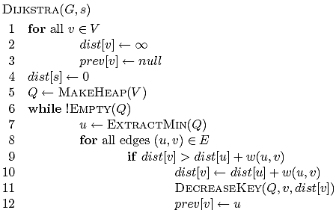
Dijkstra’s algorithm

Slide 15
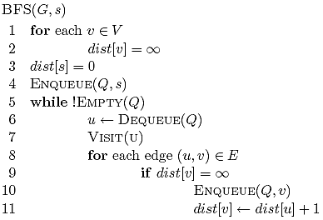
Dijkstra’s algorithm

Slide 16
Dijkstra’s algorithm
prev keeps track of
the shortest path

Slide 17
Dijkstra’s algorithm

Slide 18
Dijkstra’s algorithm

Slide 19
Dijkstra’s algorithm

Slide 20
Single source shortest paths
All of the shortest path algorithms we’ll look at today are call “single source shortest paths” algorithms
Why?

Slide 21
3
B
D
3
1
A
1
2
1
C
E
4

Slide 22
∞
∞
3
B
D
3
∞
1
A
1
2
∞
1
C
E
∞
4

Slide 23
Heap
A 0
B ∞
C ∞
D ∞
E ∞
∞
∞
3
B
D
3
0
1
A
1
2
∞
1
C
E
∞
4

Slide 24
Heap
B ∞
C ∞
D ∞
E ∞
∞
∞
3
B
D
3
0
1
A
1
2
∞
1
C
E
∞
4

Slide 25
Heap
B ∞
C ∞
D ∞
E ∞
∞
∞
3
B
D
3
0
1
A
1
2
∞
1
C
E
∞
4

Slide 26
Heap
C 1
B ∞
D ∞
E ∞
∞
∞
3
B
D
3
0
1
A
1
2
1
1
C
E
∞
4

Slide 27
Heap
C 1
B ∞
D ∞
E ∞
∞
∞
3
B
D
3
0
1
A
1
2
1
1
C
E
∞
4

Slide 28
Heap
C 1
B 3
D ∞
E ∞
3
∞
3
B
D
3
0
1
A
1
2
1
1
C
E
∞
4

Slide 29
Heap
C 1
B 3
D ∞
E ∞
3
∞
3
B
D
3
0
1
A
1
2
1
1
C
E
∞
4

Slide 30
Heap
B 3
D ∞
E ∞
3
∞
3
B
D
3
0
1
A
1
2
1
1
C
E
∞
4

Slide 31
Heap
B 3
D ∞
E ∞
3
∞
3
B
D
3
0
1
A
1
2
1
1
C
E
∞
4

Slide 32
Heap
B 3
D ∞
E ∞
3
∞
3
B
D
3
0
1
A
1
2
1
1
C
E
∞
4

Slide 33
Heap
B 2
D ∞
E ∞
2
∞
3
B
D
3
0
1
A
1
2
1
1
C
E
∞
4

Slide 34
Heap
B 2
D ∞
E ∞
2
∞
3
B
D
3
0
1
A
1
2
1
1
C
E
∞
4

Slide 35
Heap
B 2
E 5
D ∞
2
∞
3
B
D
3
0
1
A
1
2
1
1
C
E
5
4

Slide 36
Heap
B 2
E 5
D ∞
2
∞
3
B
D
3
0
1
A
1
2
Frontier?
1
1
C
E
5
4

Slide 37
Heap
B 2
E 5
D ∞
2
∞
3
B
D
3
0
All nodes reachable from starting node within a given distance
1
A
1
2
1
1
C
E
5
4

Slide 38
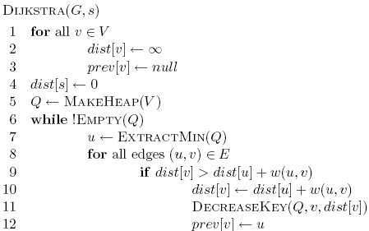
Heap
E 3
D 5
2
5
3
B
D
3
0
1
A
1
2
1
1
C
E
3
4

Slide 39
Heap
D 5
2
5
3
B
D
3
0
1
A
1
2
1
1
C
E
3
4

Slide 40
Heap
2
5
3
B
D
3
0
1
A
1
2
1
1
C
E
3
4

Slide 41
Heap
2
5
3
B
D
0
1
A
1
1
1
C
E
3

Slide 42
Is Dijkstra’s algorithm correct?
Invariant:

Slide 43
Is Dijkstra’s algorithm correct?
Invariant: For every vertex removed from the heap, dist[v] is the actual shortest distance from s to v

Slide 44
Is Dijkstra’s algorithm correct?
Invariant: For every vertex removed from the heap, dist[v] is the actual shortest distance from s to v
  The only time a vertex gets visited is when the distance from s to that vertex is smaller than the distance to any remaining vertex
  Therefore, there cannot be any other path that hasn’t been visited already that would result in a shorter path

Slide 45
Running time?

Slide 46
Running time?
1 call to MakeHeap

Slide 47
Running time?
|V| iterations

Slide 48
Running time?
|V| calls

Slide 49
Running time?
O(|E|) calls

Slide 50
Running time?
Depends on the heap implementation
1 MakeHeap
|V| ExtractMin
|E| DecreaseKey
Total
Array
O(|V|)
O(|V|²)
O(|E|)
O(|V|²)
Bin heap
O(|V|)
O(|V| log |V|)
O(|E| log |V|)
O((|V|+|E|) log |V|)
O(|E| log |V|)

Slide 51
Running time?
Depends on the heap implementation
1 MakeHeap
|V| ExtractMin
|E| DecreaseKey
Total
Array
O(|V|)
O(|V|²)
O(|E|)
O(|V|²)
Bin heap
O(|V|)
O(|V| log |V|)
O(|E| log |V|)
O((|V|+|E|) log |V|)
O(|E| log |V|)
Is this an improvement?
If |E| < |V|² / log |V|

Slide 52
Running time?
Depends on the heap implementation
1 MakeHeap
|V| ExtractMin
|E| DecreaseKey
Total
Array
O(|V|)
O(|V|²)
O(|E|)
O(|V|²)
Bin heap
O(|V|)
O(|V| log |V|)
O(|E| log |V|)
O((|V|+|E|) log |V|)
O(|E| log |V|)
Fib heap
O(|V|)
O(|V| log |V|)
O(|E|)
O(|V| log |V| + |E|)

Slide 53
What about Dijkstra’s on…?
1
1
B
D
A
5
10
-10
C
E

Slide 54
What about Dijkstra’s on…?
1
1
B
D
A
5
10
-10
C
E

Slide 55
What about Dijkstra’s on…?
Dijkstra’s algorithm only works for positive edge weights
1
1
B
D
A
5
10
C
E

Slide 56
Bounding the distance
Another invariant: For each vertex v, dist[v] is an upper bound on the actual shortest distance
  start of at ∞
  only update the value if we find a shorter distance
An update procedure

Slide 57
Can we ever go wrong applying this update rule?
  We can apply this rule as many times as we want and will never underestimate dist[v]
When will dist[v] be right?
  If u is along the shortest path to v and dist[u] is correct

Slide 58
dist[v] will be right if u is along the shortest path to v and dist[u] is correct
Consider the shortest path from s to v
s
p₁
p₂
p₃
p_{k}
v

Slide 59
dist[v] will be right if u is along the shortest path to v and dist[u] is correct
What happens if we update all of the vertices with the above update?
s
p₁
p₂
p₃
p_{k}
v

Slide 60
dist[v] will be right if u is along the shortest path to v and dist[u] is correct
What happens if we update all of the vertices with the above update?
s
p₁
p₂
p₃
p_{k}
v
correct

Slide 61
dist[v] will be right if u is along the shortest path to v and dist[u] is correct
What happens if we update all of the vertices with the above update?
s
p₁
p₂
p₃
p_{k}
v
correct
correct

Slide 62
dist[v] will be right if u is along the shortest path to v and dist[u] is correct
Does the order that we update the vertices matter?
s
p₁
p₂
p₃
p_{k}
v
correct
correct

Slide 63
dist[v] will be right if u is along the shortest path to v and dist[u] is correct
How many times do we have to do this for vertex p_{i} to have the correct shortest path from s?
  i times
s
p₁
p₂
p₃
p_{k}
v

Slide 64
dist[v] will be right if u is along the shortest path to v and dist[u] is correct
How many times do we have to do this for vertex p_{i} to have the correct shortest path from s?
  i times
s
p₁
p₂
p₃
p_{k}
v
correct
correct

Slide 65
dist[v] will be right if u is along the shortest path to v and dist[u] is correct
How many times do we have to do this for vertex p_{i} to have the correct shortest path from s?
  i times
s
p₁
p₂
p₃
p_{k}
v
correct
correct
correct

Slide 66
dist[v] will be right if u is along the shortest path to v and dist[u] is correct
How many times do we have to do this for vertex p_{i} to have the correct shortest path from s?
  i times
s
p₁
p₂
p₃
p_{k}
v
correct
correct
correct
correct

Slide 67
dist[v] will be right if u is along the shortest path to v and dist[u] is correct
How many times do we have to do this for vertex p_{i} to have the correct shortest path from s?
  i times
s
p₁
p₂
p₃
p_{k}
v
…
correct
correct
correct
correct

Slide 68
dist[v] will be right if u is along the shortest path to v and dist[u] is correct
What is the longest (vetex-wise) the path from s to any node v can be?
  |V| - 1 edges/vertices
s
p₁
p₂
p₃
p_{k}
v
…
correct
correct
correct
correct

Slide 69
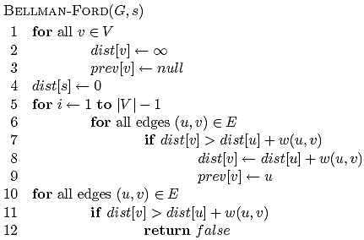
Bellman-Ford algorithm

Slide 70
Bellman-Ford algorithm
Initialize all the distances

Slide 71
Bellman-Ford algorithm
iterate over all edges/vertices and apply update rule

Slide 72
Bellman-Ford algorithm

Slide 73
Bellman-Ford algorithm
check for negative cycles

Slide 74
Negative cycles
What is the shortest path from a to e?
1
1
B
D
A
5
10
-10
C
E
3

Slide 75
Bellman-Ford algorithm

Slide 76
Bellman-Ford algorithm
10
How many edges is the shortest path from s to:
S
A
8
1
G
-4
B
A:
2
1
1
-2
C
F
-1
3
E
D
-1

Slide 77
Bellman-Ford algorithm
10
How many edges is the shortest path from s to:
S
A
8
1
G
-4
B
A:
3
2
1
1
-2
C
F
-1
3
E
D
-1

Slide 78
Bellman-Ford algorithm
10
How many edges is the shortest path from s to:
S
A
8
1
G
-4
B
A:
3
2
1
1
-2
B:
F
C
-1
3
E
D
-1

Slide 79
Bellman-Ford algorithm
10
How many edges is the shortest path from s to:
S
A
8
1
G
-4
B
A:
3
2
1
1
-2
B:
5
F
C
-1
3
E
D
-1

Slide 80
Bellman-Ford algorithm
10
How many edges is the shortest path from s to:
S
A
8
1
G
-4
B
A:
3
2
1
1
-2
B:
5
F
C
-1
3
E
D
D:
-1

Slide 81
Bellman-Ford algorithm
10
How many edges is the shortest path from s to:
S
A
8
1
G
-4
B
A:
3
2
1
1
-2
B:
5
F
C
-1
3
E
D
D:
7
-1

Slide 82
Bellman-Ford algorithm
0
∞
10
S
A
Iteration: 0
8
1
∞
∞
G
-4
B
2
1
1
-2
C
∞
F
∞
-1
3
E
D
-1
∞
∞

Slide 83
Bellman-Ford algorithm
0
10
10
S
A
Iteration: 1
8
1
∞
8
G
-4
B
2
1
1
-2
C
∞
F
∞
-1
3
E
D
-1
∞
∞

Slide 84
Bellman-Ford algorithm
0
10
10
S
A
Iteration: 2
8
1
∞
8
G
-4
B
2
1
1
-2
C
∞
F
9
-1
3
E
D
-1
12
∞

Slide 85
Bellman-Ford algorithm
0
5
10
S
A
Iteration: 3
8
1
10
8
G
-4
B
A has the correct distance and path
2
1
1
-2
C
∞
F
9
-1
3
E
D
-1
8
∞

Slide 86
Bellman-Ford algorithm
0
5
10
S
A
Iteration: 4
8
1
6
8
G
-4
B
2
1
1
-2
C
11
F
9
-1
3
E
D
-1
7
∞

Slide 87
Bellman-Ford algorithm
0
5
10
S
A
Iteration: 5
8
1
5
8
G
-4
B
B has the correct distance and path
2
1
1
-2
C
7
F
9
-1
3
E
D
-1
7
14

Slide 88
Bellman-Ford algorithm
0
5
10
S
A
Iteration: 6
8
1
5
8
G
-4
B
2
1
1
-2
C
6
F
9
-1
3
E
D
-1
7
10

Slide 89
Bellman-Ford algorithm
0
5
10
S
A
Iteration: 7
8
1
5
8
G
-4
B
D (and all other nodes) have the correct distance and path
2
1
1
-2
C
6
F
9
-1
3
E
D
-1
7
9

Slide 90

Correctness of Bellman-Ford
Loop invariant:

Slide 91
Correctness of Bellman-Ford
Loop invariant: After iteration i, all vertices with shortest paths from s of length i edges or less have correct distances

Slide 92
Runtime of Bellman-Ford
O(|V| |E|)

Slide 93
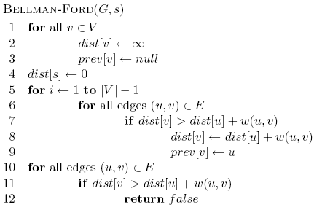
Runtime of Bellman-Ford
Can you modify the algorithm to run faster (in some circumstances)?

Slide 94
All pairs shortest paths
Simple approach
  Call Bellman-Ford |V| times
  O(|V|² |E|)
Floyd-Warshall – Θ(|V|³)
Johnson’s algorithm – O(|V|² log |V| + |V| |E|)

Slide 95
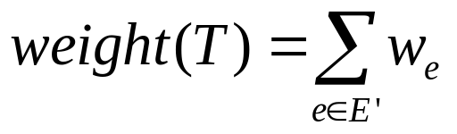
Minimum spanning trees
What is the lowest weight set of edges that connects all vertices of an undirected graph with positive weights
Input: An undirected, positive weight graph, G=(V,E)
Output: A tree T=(V,E’) where E’ ⊆ E that minimizes

Slide 96
MST example
1
A
C
E
3
4
4
4
2
5
B
D
F
4
6
1
A
C
E
4
4
2
5
B
D
F

Slide 97
MSTs
Can an MST have a cycle?
1
A
C
E
4
4
2
5
B
D
F
4

Slide 98
MSTs
Can an MST have a cycle?
1
A
C
E
4
4
2
5
B
D
F

Slide 99
Applications?
Connectivity
  Networks (e.g. communications)
  Circuit desing/wiring
hub/spoke models (e.g. flights, transportation)
Traveling salesman problem?

Slide 100
Cuts
A cut is a partitioning of the vertices into two sets S and V-S
An edges “crosses” the cut if it connects a vertex u∈V and v∈V-S
1
A
C
E
3
4
4
4
2
5
B
D
F
4
6

Slide 101
Minimum cut property
Given a partion S, let edge e be the minimum cost edge that crosses the partition. Every minimum spanning tree contains edge e.
S
V-S
e
e’
Consider an MST with edge e’ that is not the minimum edge

Slide 102
Minimum cut property
Given a partion S, let edge e be the minimum cost edge that crosses the partition. Every minimum spanning tree contains edge e.
S
V-S
e
e’
Using e instead of e’, still connects the graph, but produces a tree with smaller weights

Slide 103
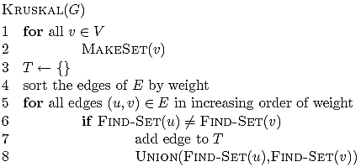
Algorithm ideas?
Given a partion S, let edge e be the minimum cost edge that crosses the partition. Every minimum spanning tree contains edge e.

Slide 104
Kruskal’s algorithm
Add smallest edge that connects two sets not already connected
1
A
C
E
3
4
5
4
4
2
MST
B
D
F
4
6
A
C
E
G
B
D
F

Slide 105
Kruskal’s algorithm
Add smallest edge that connects two sets not already connected
1
A
C
E
3
4
5
4
4
2
MST
B
D
F
4
6
1
A
C
E
G
B
D
F

Slide 106
Kruskal’s algorithm
Add smallest edge that connects two sets not already connected
1
A
C
E
3
4
5
4
4
2
MST
B
D
F
4
6
1
A
C
E
G
2
B
D
F

Slide 107
Kruskal’s algorithm
Add smallest edge that connects two sets not already connected
1
A
C
E
3
4
5
4
4
2
MST
B
D
F
4
6
1
A
C
E
G
4
2
B
D
F

Slide 108
Kruskal’s algorithm
Add smallest edge that connects two sets not already connected
1
A
C
E
3
4
4
4
2
5
MST
B
D
F
4
6
1
A
C
E
G
4
4
2
B
D
F

Slide 109
Kruskal’s algorithm
Add smallest edge that connects two sets not already connected
1
A
C
E
3
4
4
4
2
5
MST
B
D
F
4
6
1
A
C
E
G
4
4
2
5
B
D
F

Slide 110
Correctness of Kruskal’s
Never adds an edge that connects already connected vertices
Always adds lowest cost edge to connect two sets. By min cut property, that edge must be part of the MST

Slide 111
Running time of Kruskal’s
|V| calls to MakeSet

Slide 112
Running time of Kruskal’s
O(|E| log |E|)

Slide 113
Running time of Kruskal’s
2 |E| calls to FindSet

Slide 114
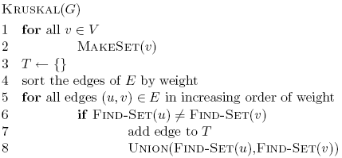
Running time of Kruskal’s
|V| calls to Union

Slide 115
Running time of Kruskal’s
Disjoint set data structure
O(|E| log |E|) +
MakeSet
FindSet
|E| calls
Union
|V| calls
Total
Linked lists
|V|
O(|V| |E|)
|V|
O(|V||E| + |E| log |E|)
O(|V| |E|)
Linked lists +
heuristics
|V|
O(|E| log |V|)
|V|
O(|E| log |V|+ |E| log |E|)
O(|E| log |E| )

Slide 116
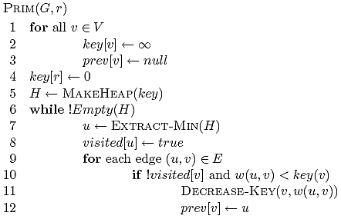
Prim’s algorithm

Slide 117
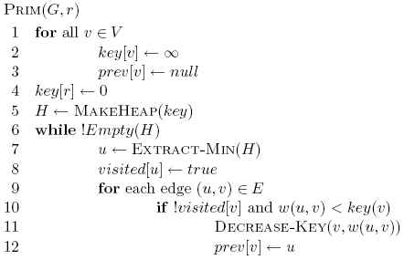
Prim’s algorithm

Slide 118
Prim’s algorithm

Slide 119
Prim’s algorithm
Start at some root node and build out the MST by adding the lowest weighted edge at the frontier

Slide 120
Prim’s
1
A
C
E
3
4
5
MST
4
4
2
B
D
F
4
6
A
C
E
B
D
F

Slide 121
Prim’s
1
A
C
E
3
4
5
MST
4
4
2
∞
∞
∞
B
D
F
4
6
A
C
E
B
D
F
∞
∞
0

Slide 122
Prim’s
1
A
C
E
3
4
5
MST
4
4
2
∞
4
5
B
D
F
4
6
A
C
E
B
D
F
∞
6
0

Slide 123
Prim’s
1
A
C
E
3
4
5
MST
4
4
2
∞
4
5
B
D
F
4
6
A
C
E
B
D
F
∞
6
0

Slide 124
Prim’s
1
A
C
E
3
4
5
MST
4
4
2
1
4
5
B
D
F
4
6
A
C
E
B
D
F
4
2
0

Slide 125
Prim’s
1
A
C
E
3
4
5
MST
4
4
2
1
4
5
B
D
F
4
6
A
C
E
B
D
F
4
2
0

Slide 126
Prim’s
1
A
C
E
3
4
5
MST
4
4
2
1
4
5
B
D
F
4
6
A
C
E
B
D
F
4
2
0

Slide 127
Prim’s
1
A
C
E
3
4
5
MST
4
4
2
1
4
5
B
D
F
4
6
A
C
E
B
D
F
4
2
0

Slide 128
Prim’s
1
A
C
E
3
4
5
MST
4
4
2
1
4
5
B
D
F
4
6
A
C
E
B
D
F
4
2
0

Slide 129
Prim’s
1
A
C
E
3
4
5
MST
4
4
2
1
4
5
B
D
F
4
6
A
C
E
B
D
F
4
2
0

Slide 130
Prim’s
1
A
C
E
3
4
5
MST
4
4
2
1
4
5
B
D
F
4
6
A
C
E
B
D
F
4
2
0

Slide 131
Prim’s
1
A
C
E
3
4
5
MST
4
4
2
1
4
5
B
D
F
4
6
A
C
E
B
D
F
4
2
0

Slide 132
Correctness of Prim’s?
Can we use the min-cut property?
  Given a partion S, let edge e be the minimum cost edge that crosses the partition. Every minimum spanning tree contains edge e.
Let S be the set of vertices visited so far
The only time we add a new edge is if it’s the lowest weight edge from S to V-S

Slide 133
Running time of Prim’s
Θ(|V|)

Slide 134
Running time of Prim’s
Θ(|V|)

Slide 135
Running time of Prim’s
|V| calls to Extract-Min

Slide 136
Running time of Prim’s
|E| calls to Decrease-Key

Slide 137
Running time of Prim’s
Same as Dijksta’s algorithm
1 MakeHeap
|V| ExtractMin
|E| DecreaseKey
Total
Array
O(|V|)
O(|V|²)
O(|E|)
O(|V|²)
Bin heap
O(|V|)
O(|V| log |V|)
O(|E| log |V|)
O((|V|+|E|) log |V|)
O(|E| log |V|)
Fib heap
O(|V|)
O(|V| log |V|)
O(|E|)
O(|V| log |V| + |E|)
Kruskal’s: O(|E| log |E| )

